Slide 1


Cyber Security
Course 1
Cryptography Fundamentals

Slide 2



About Me
Daniel Cozmescu - M. Sc.
Educational Background – IESC, Transylvania University
Bachelor’s Degree in Computer Science – Summa cum laude
Master’s Degree in Cybersecurity – Magna cum laude
Professional Experience – Mainly IBM
Siemens Summer School – C#, C/C++, Java, Git
Learned C#, C/C++, Java, and Git through hands-on projects. Built strong foundations in programming and version control.
IBM Summer School – ORACLE SQL Database
Focused on SQL Administration. Gained solid skills in database management and query optimization.
IBM Internship – IT Infrastructure
Worked on IT infrastructure tasks. Improved scripting, automation, and problem-solving in real-world environments.
Junior Infrastructure Specialist
Maintained and supported IT systems. Gained experience in networks, servers, and basic automation.
DevOps & Automation Engineer
Built CI/CD pipelines, automated deployments, password rotations, business processes and improved system reliability. Strong in scripting, cloud, and tools like Jenkins, AWS, Python, Bash, AWS CLI, Terraform.
Senior DevOps & Automation Engineer
Led automation initiatives, improved ticket solving techniques from manual to automated solving using AI. Skilled in cloud platforms, advanced CI/CD, monitoring, and team mentorship.

Slide 3




About Me
Daniel Cozmescu - M. Sc.
Personal Background → Useful for a later exercise
Proudly a cat owner – Sticks
Photography and videography – Canon & DJI
Driving a Civic

Slide 4
About yourselves
What is your name?
Which faculty are you representing in our adventure today?
If you could create your dream job, what would it look like? And what field?
Why did you start coding — love at first semicolon, or were you just trying to fix your Wi-Fi?

Slide 5
Integrity aims to protect the correctness and completeness of information and processing methods. It involves the implementation of a set of appropriate measures that do not allow the alteration modification or destruction of information by malicious persons. The control measures put in place must define the users who have the right to access and modify the information, as well as the methods and means of retrieving the information in case of destruction or loss due to a hardware, software, human error or error of the security systems
Confidentiality ensures that the information is accessible only to entities that are authorized to access the resource.
To ensure confidentiality, all information that needs to be protected must be identified, as well as its owner and the people who must have access to it.
Ensuring confidentiality involves several standardized measures to protect against unauthorized access to data and information.
Availability aims to ensure that authorized users have access to information and associated goods when they are needed.
A
I
What is CIA triad?
C

Slide 6
Virus
Ransomware
Adware is often bundled with free software and automatically displays or downloads advertising material when the host software is used. It can be a nuisance and often degrade system performance or user experience.
A Trojan horse, or simply Trojan, is a type of malware that disguises itself as legitimate software. Users are tricked into loading and executing the malware on their systems. Once activated, Trojans can enable cyber-criminals to spy on you, steal sensitive data, and gain backdoor access to your system.
A worm is similar to a virus, but it can replicate itself and spread independently across networks without human interaction. Once a worm infects a device, it can send copies of itself to other devices connected to the network. This ability to spread itself makes worms particularly dangerous, as they can spread rapidly across a network.
Ransomware is a type of malware that locks and encrypts a victim’s data and then demands payment to unlock and decrypt the data. Payments are typically demanded in a cryptocurrency such as Bitcoin to preserve the anonymity of the transaction.
Spyware is a type of malware that secretly observes the user's computer activities without consent and reports it to the software's author. It can capture everything from your keystrokes to your browsing history and credit card information.
A virus is a type of malware that attaches itself to a legitimate program or file enabling it to spread from one computer to another. When the infected program is executed, the virus also executes, potentially causing damage, corrupting files, or spreading to other systems.
Worm
Cyber Threats
Spyware
Trojan
Adware

Slide 7

Threats to information are generated by
Human causes
(errors, negligence, hacking, cracking, phishing, malware, sabotage, espionage, terrorism, etc.)
Causes related to costs
(inadequate processes, cheap solutions, insufficient testing)
Technical causes
(hardware, software)
External causes
(natural disasters fire, water , earthquake, incidents , accidents , terrorism)

Slide 8
Cryptography = hidden/secret writing
From ancient Greece
Kryptos = hidden/secret
Graphein = to write

Slide 9
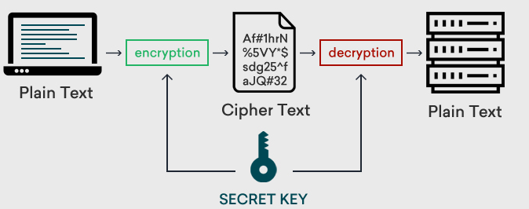
Symmetric Encryption
Encryption is the process of converting information or data into a secure format that cannot be read without a key.
Key Feature: Uses the same key for both encryption and decryption.
Speed: Generally faster than asymmetric encryption.
Use Case: Ideal for encrypting large amounts of data, such as database encryption.
Example: AES* (Advanced Encryption Standard)
*For more information about how AES works at low level, click here

Slide 10
Symmetric Encryption
Other symmetric encryption algorithms:
AES - Widely regarded as the gold standard for symmetric encryption
DES - phased out due to its vulnerability to brute-force attacks due to its shorter key length (56 bits). It has been superseded by AES.
3DES - slower than AES and also considered less secure today due to its effective key length and block size.
Blowfish - a block cipher that can be used in place of DES or AES in many applications
Twofish - It was one of the finalists in the AES selection process and is known for its speed and security.
RC4 - Originally designed for secure communications over networks, popular in protocols like SSL (to secure Internet traffic). However, vulnerabilities have led to its decline in favor of more secure methods.
RC5 - This is a fast block cipher designed to be easy to implement in both hardware and software. It supports a variety of block sizes, key sizes, and rounds.
RC6 - A symmetric key block cipher derived from RC5. It was also a finalist in the AES selection process and features a complex key schedule and data-dependent rotations.

Slide 11
Block Ciphers
Block ciphers are a type of symmetric encryption algorithm that operates on a fixed-size block of data using a specific, shared key. Here’s a breakdown of how block ciphers work and their important characteristics:
Basic Operation
Fixed Block Size: Block ciphers encrypt data in blocks of a fixed size, typically 64 or 128 bits. If the plaintext data does not perfectly fill a block, it must be padded to reach the required block size.
Encryption Key: The cipher uses a symmetric key, which means the same key is used for both encryption and decryption. The security of the cipher largely depends on the secrecy of this key.
Encryption Process: The plaintext block is transformed into a ciphertext block through a series of well-defined operations — typically a combination of substitution, permutation, and mixing of the plaintext and key.
Decryption Process: This is the reverse of the encryption process, utilizing the same key to transform the ciphertext back into the original plaintext.
Symmetric Encryption

Slide 12
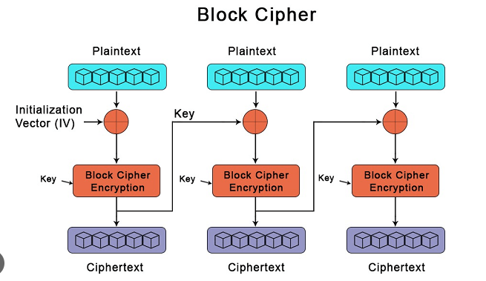
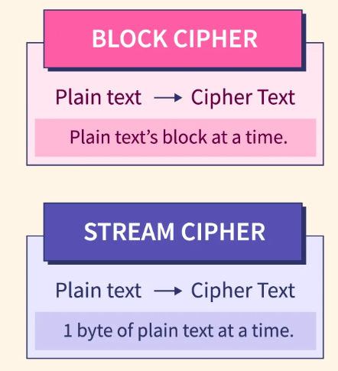
Symmetric Encryption
Block ciphers by themselves can only securely encrypt a single block of data. To encrypt messages longer than the block size, different modes of operation are used, such as:
ECB (Electronic Codebook Mode): Each block is encrypted independently, which can lead to security issues like pattern leakage since identical plaintext blocks produce identical ciphertext blocks.
CBC (Cipher Block Chaining Mode): Each block of plaintext is XORed (exclusive OR) with the previous ciphertext block before being encrypted, which helps to hide patterns in the plaintext.
CFB (Cipher Feedback Mode) and OFB (Output Feedback Mode): These turn a block cipher into a stream cipher, allowing it to encrypt data of any size without needing padding.

Slide 13
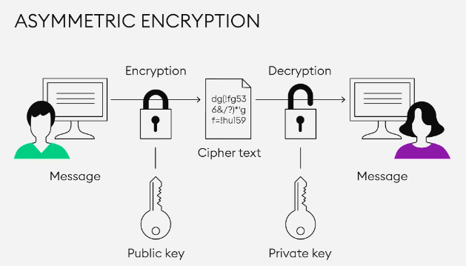

Asymmetric Encryption
What is asymmetric encryption?
As the name implies, asymmetric encryption is different on each side; the sender and the recipient use two different keys.
Asymmetric encryption, also known as public key encryption, uses a public key-private key pairing: data encrypted with the public key can only be decrypted with the private key.
TLS (or SSL), the protocol that makes HTTPS possible, relies partially on asymmetric encryption. A client will obtain a website's public key from that website's TLS certificate (or SSL certificate) and use that to initiate secure communication. The website keeps the private key secret.

Slide 14
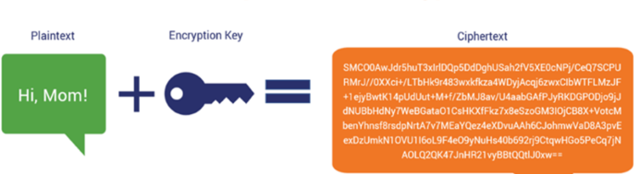
How does a cryptographic key work?
A key is a string of data that, when used in conjunction with a cryptographic algorithm, encrypts or decrypts messages. Data encrypted with the key will look like a random series of characters, but anyone with the right key can put it back into plaintext form. (A key can also be used to digitally sign data, not just for encryption.)
Asymmetric Encryption

Slide 15
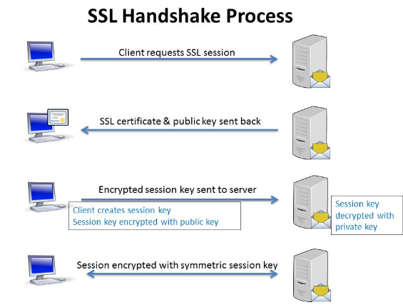
Asymmetric cryptography can also be applied to systems in which many users might need to encrypt and decrypt messages, including the following:
Encrypted email - A public key can encrypt an email message, and a private key can decrypt it.
SSL/TLS - Establishing encrypted links between websites and browsers also uses asymmetric encryption.
Cryptocurrencies - Bitcoin and other cryptocurrencies rely on asymmetric cryptography. Users have public keys that everyone can see and private keys that are kept secret. Bitcoin uses a cryptographic algorithm to ensure only legitimate owners can spend the funds.
Asymmetric Encryption

Slide 16
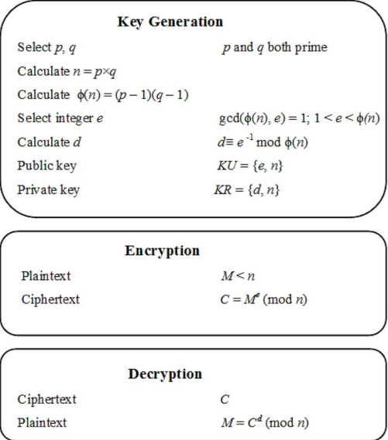
Asymmetric Encryption
RSA (Rivest-Shamir-Adleman)
One of the earliest public-key systems and still widely used today.
RSA is based on the mathematical difficulty of factoring large integers that are the product of two large prime numbers.
Uses: Digital signatures, secure data transmission, and encryption of small blocks of data (such as encryption keys and hash values for digital signatures).

Slide 17
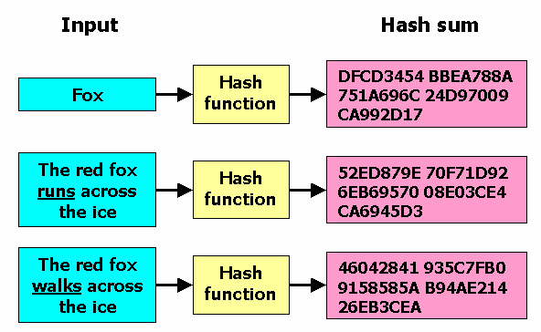
Hash Functions
Definition: Hash functions convert input data (of any size) into a fixed-size string of bytes, typically a digest that is unique to the input data.
Properties
Deterministic: The same input always produces the same output.
Fast Computation: Hash values are quick to compute.
Pre-image Resistance: It should be difficult to generate an input that hashes to a specific output.
Small Changes, Big Differences: A tiny change in input drastically changes the output.
Collision Resistant: It should be difficult to find two different inputs that produce the same output.
Examples : MD5 (Message Digest Algorithm 5), Sha1Sum (Secure hash algorithm 1),

Slide 18
Hash Functions
Definition: Hash functions convert input data (of any size) into a fixed-size string of bytes, typically a digest that is unique to the input data.
Takeaway
If you modify even 1 bit in the initial plain text string (e.g. instead of Fox you type Nox),
the output itself will be a total different hash sum.
In the context of MD5 for example, it has a deterministic output, meaning that it will always
generate the same hash output for the same input.
Every time you hash a particular piece of data using MD5, you will get exactly the same hash value.
Fixed Output Size: Regardless of the input size, whether it's a single character or a large file,
MD5 will always produce a fixed 128-bit hash.
Current Use: Despite its vulnerabilities, MD5 is still in use today for legacy applications and non-security applications where a quick and simple checksum is sufficient, such as in file integrity checks where security is not a concern.

Slide 19
Hands-On Laboratory – Hash Sums
Open your Kali Linux Instances and initiate a new terminal
Go to Desktop (/home/kali/Desktop)
Using a hashing algorithm (md5sum or sha1sum), validate the information we just discussed as it follows:
Create a new file named hashing.txt (touch hashing.txt)
Grant it privileges (chmod ug+rwx hashing.txt) (read-write-execute privilege add for user and group for hashing.txt file)
Write something in it (either by VI into it, or by writing some info through echo (echo “IBM” > hashing.txt)
Generate a new hash using “sha1sum hashing.txt” or “md5sum hashing.txt”
Execute the command one more time. What do you observe here?
Now append 1 char to the file again (echo “M” >> hashing.txt) Execute the command one more time. What do you observe here?
Now, in order to find out the length of the hash, execute:
md5sum hashing.txt | awk '{print $1}' | wc –c
(Command explanation: Generate the hashing sum, which will output the hash sum itself and the filename, take only the first word in this string using parameter $1 with AWK utility, which in fact is the hashsum, and count using wc the characters in it. )
Now execute it again replacing md5sum with sha1sum also.
What can you tell here?

Slide 20
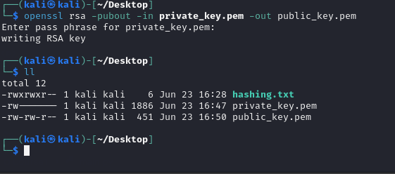
Hands-On Laboratory – Asymmetric Encryption
Open your Kali Linux Instances and initiate a new terminal
Go to Desktop (/home/kali/Desktop)
2. Using RSA, we need to generate RSA keys (private then public keys), encrypt the file using recipient public key, and decrypt it using recipient private key.
Generate RSA Keys using:
openssl genpkey -algorithm RSA -out private_key.pem -aes256
Enter a “passphrase” between 4-1024 characters for example : “crypto”
The output should be a file named private_key.pem. Execute “cat private_key.pem” to see it’s encoded content.
Extract public key using:
openssl rsa -pubout -in private_key.pem -out public_key.pem
Enter the same passphrase you used previously.
You should see a public_key.pem file.
Again using cat command, display the file content.

Slide 21
Hands-On Laboratory – Asymmetric Encryption
Encrypt the file using the recipient public key using:
openssl rsautl -encrypt -pubin -inkey public_key.pem -in hashing.txt -out hashing_encrypted.dat
- rsautl command can be used to sign, verify, encrypt and decrypt data using the RSA algorithm
-pubin: Specifies that the input file (public_key.pem) is a public key.
-inkey public_key.pem: Specifies the public key file.
-in hashing.txt: Specifies the input plaintext file (hashing.txt).
-out hashing_encrypted.dat: Specifies the output encrypted file (hashing_encrypted.dat).
The output should be a file named hashing_encrypted.dat
Inside it, if you output it’s content, “cat hashing_encrypted.dat”, you will see that the plain text has been encrypted using the public key.
Now in order to revert the encryption of the file, we need to decrypt it using the private key (early derived from the public key itself) using:
openssl rsautl -decrypt -inkey private_key.pem -in hashing_encrypted.dat -out hashing_decrypted.txt
-inkey private_key.pem: Specifies the private key file.
-in hashing_encrypted.dat: Specifies the input encrypted file (hashing_encrypted.dat).
-out hashing_decrypted.txt: Specifies the output decrypted file (hashing_decrypted.txt).
Now you should see a file named hashing_decrypted.txt, and if you output it’s content, the plain text should appear again.

Slide 22
Hands-On Laboratory – Symmetric Encryption
Generate AES Key using the following command as a file:
openssl rand -out aes_key.bin 32
The command randomly generates an aes key of 32 byte(256bit) and export it using out to aes_key.bin
Encrypt the file using:
openssl enc -aes-256-cbc -salt -in hashing.txt -out hashing_encrypted_aes.dat -pass file:aes_key.bin
Openssl – utility to encrypt, decrypt, generate keys
Enc – the module which we are using (encrypt/decrypt)
-aes-256-cbc – what type of encryption we are using, aes256(as the key was generated for 256 bits for this type of encryption, and we are using block cipher CBC)
Salt – for example if we defragment the data into a low level understanding, the following : “IBM” in size will not be 32 bytes itself, but less, so we pad it (add some random padding to achieve/reach the desired length). (Padding in cybersecurity basically means if you cannot encrypt a text of exactly the size you generated the key, you will pad it until it reaches the desired length.
In means that we want to encrypt the mentioned txt
Out is the results of the encryption ( a new file )
Pass means the password or the key itself which in fact for us is the file aes_key.bin

Slide 23
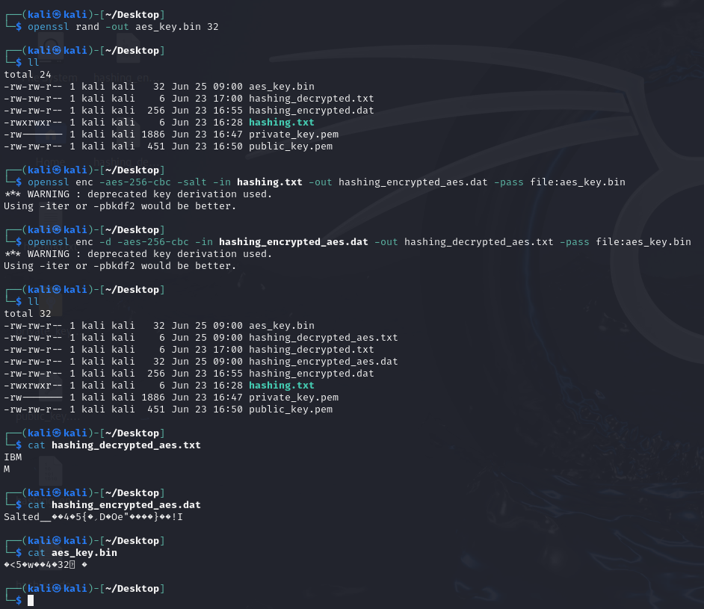
Hands-On Laboratory – Symmetric Encryption
In order to decrypt the information, we will use the same key (bin key file) using the following command:
openssl enc -d -aes-256-cbc -in hashing_encrypted_aes.dat -out hashing_decrypted_aes.txt -pass file:aes_key.bin
Enc –d = decrypt command
-aes-256-cbc same as before, must be mentioned so we decrypt it using reverse engineering based on the encrypt command
-in will get the encrypted file
-out will be the plain text decrypted file
-pass is the same for encryption as much as for decryption
(as an exercise or curiosity, you can take also a look using CAT command into each file to see the results of the commands)

Slide 24
Homework for Session 3
Using Asymmetric, Symmetric and Hashing methodologies:
1. (Easy) Generate an SSH key pair using RSA and output the content of the files. (Research knowledge on the internet on how to create using RSA a SSH key pair)
2. (Medium) Encrypt symmetrically the “hashing.txt” file from the laboratory using:
2 other different block ciphers (ECB, CFB)
another size for the key and cipher (128 or 192 bits)
an IV vector (an IV vector is used in encryption to assure that if we have 2 identical plaintext blocks, they will be encrypted differently so a hacker cannot access the information behind it by pattern-matching techniques, please research online and find how to generate a file containing the IV and include it into the command)
As an example, without an IV, a text such as:
“The password is a strong password that the user is using and sends the password to a colleague”
We have 3 encounters of the same word, and if a hacker can get access to the encryption, without the IV, he can assume that the same encryption 3 times could potentially be a valuable information. So we use an IV vector to randomly encrypt each encounter here.

Slide 25
Homework for Session 3
3. (Hard) (OPTIONAL)
You've been working with a cybersecurity mentor, codename Leinad, who suddenly went off the grid.
Before disappearing, Leinad left behind a mysterious encrypted video file labeled confession.mp4.enc.You're part of a trusted group of students Leinad trained — and it's now up to you to uncover the message.
On Leinad’s secure desk, you found a handwritten note:
“You know that presentation about me that I’ve sent to you over email a long time ago, on our PERSONAL Telegram chat ? Use it wisely so you can hear my last message for you. That’s the only BACKGROUND you will only have together with me. No pics, no shows, good luck kid”.
You also found a cryptic hash scribbled on a sticky note: 767ae4575f235465c0318145d85cd947
On his desk, he also engraved something encrypted with Caesar’s cipher:
rshqvvo hqf -dhv-256-fef -g -vdow -lq frqihvvlrq.hqf -rxw frqihvvlrq.ps4 -n Sxw_SZG_KHUH
Your goal is:
Decrypt the desk engraving, using a Caesar Cipher online decoder. The shift number = the number of times you usually count until running in a competition. -> the command used for decryption
2. Determine what type of hashing algorithm he used to encrypt his video decryption password (the one scribbled on the sticky note), based on it’s length. -> The type of algorithm used for hashing, determined by it’s length.
3. Gather intel on your mentor’s backgrounds, keywords of the first slides about him in his presentation once sent, and set them up in a list. -> Calculate hashes of words on the mentor’s slide about him, to find the identical match with the mentioned one 767ae4575f235465c0318145d85cd947.
Command used to find out the hash sum for each word: echo –n “<replace_your_word>” | <replace_with_hashing_algorithm>
4. You have the hash of the password scribbled on the sticky note, so you need to determine from his most personal belongings, those words, which one has an identical hash with this one. 5. After identification, use the password which matches the hash, to decrypt the video and watch it. Good luck! -> After finding the hashing match, take it’s plain text form and replace it in the command decrypted with Caesar Cipher. Run it, then watch the video. 👍

Slide 26
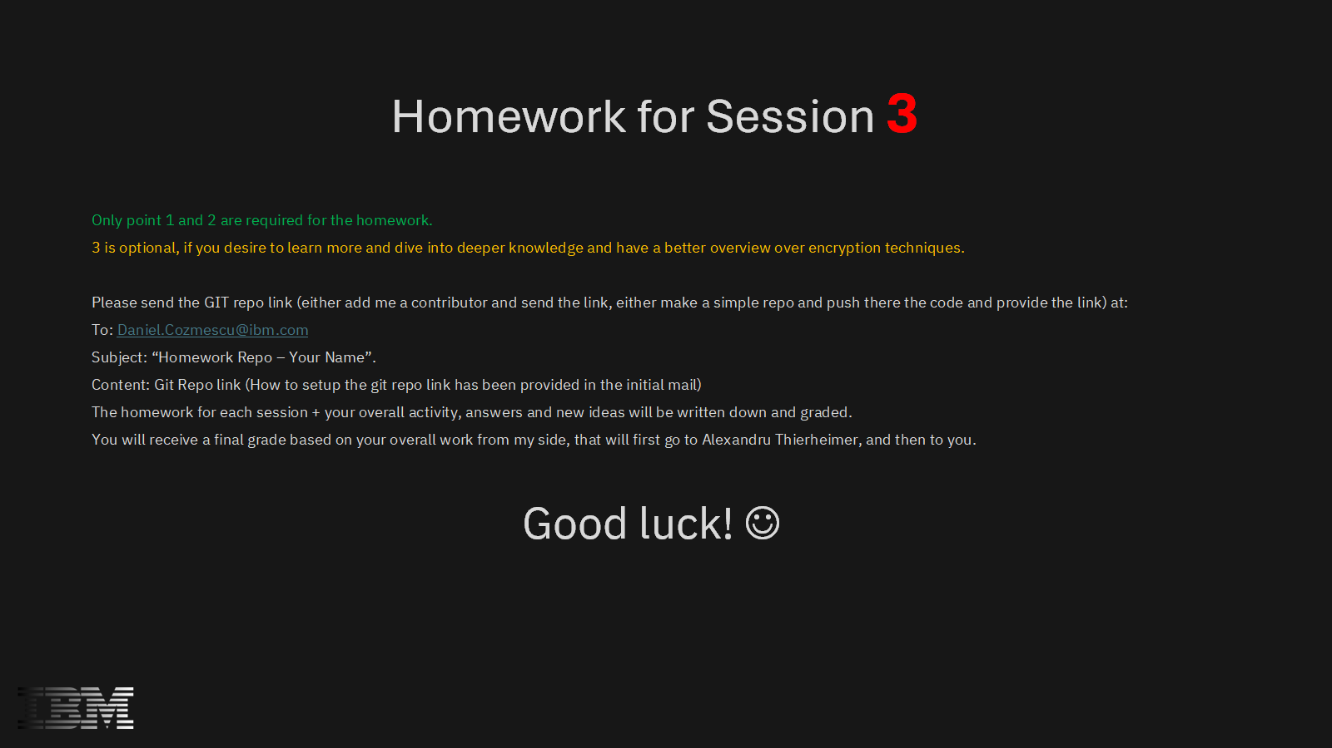
Homework for Session 2
Using Asymmetric, Symmetric and Hashing methodologies:
1. (Easy) Generate an SSH key pair using RSA and output the content of the files. (Research knowledge on the internet on how to create using RSA a SSH key pair)
2. (Medium) Encrypt symmetrically the “hashing.txt” file from the laboratory using:
2 other different block ciphers (ECB, CFB)
another size for the key and cipher (128 or 192 bits)
an IV vector (an IV vector is used in encryption to assure that if we have 2 identical plaintext blocks, they will be encrypted differently so a hacker cannot access the information behind it by pattern-matching techniques, please research online and find how to generate a file containing the IV and include it into the command)
As an example, without an IV, a text such as:
“The password is a strong password that the user is using and sends the password to a colleague”
We have 3 encounters of the same word, and if a hacker can get access to the encryption, without the IV, he can assume that the same encryption 3 times could potentially be a valuable information. So we use an IV vector to randomly encrypt each encounter here.
3. (Hard) (OPTIONAL) Use a super-encryption algorithm on a file (using the two ways learnt, encrypt both asymmetric and symmetric the same file).
(no need of IV here, you can proceed with laboratory learnt commands)
Steps:
Create a file named “IBM.txt” with the text “Kali Dragon Dracarys”
Encrypt it using asymmetric encryption (generate a new key pair, separate of the laboratory one).
Take the output of the asymmetric encryption and encrypt it using symmetric encryption.
Take the output of the symmetric encryption and decrypt using symmetric decryption.
Take the output of symmetric decryption and decrypt it using asymmetric decryption.
Compare the initial files and check if the md5sum hashes are equal. -> if equal then your encryption/decryption process succeeded.
The whole process should look like this:
IBM.txt -> IBM_encrypted_asymmetric.dat -> IBM_encrypted_symmetric.dat -> IBM_decrypted_symmetric.dat -> IBM_decrypted_asymmetric.txt
Md5sum IBM.txt is equal with md5sum IBM_decrypted_asymmetric.txt?
Content of IBM.txt is equal with content of IBM_decrypted_asymmetric.txt?

